Slide 1
Objectives and Process
The objective is to take a movie title as input and respond with the top-10 most similar movies using the MovieLens dataset
(https://grouplens.org/datasets/movielens )
For this exercise we’ll use the MovieLens Latest Dataset. Which includes:
58,000 movies
27,000,000 ratings by 280,000 users
1,100,000 tag applications
Tag genome data with 14 million relevance scores across 1,100 tags
Variable Selection
Algorithm implementation
Data Preprocessing
Analyze Results

Slide 2
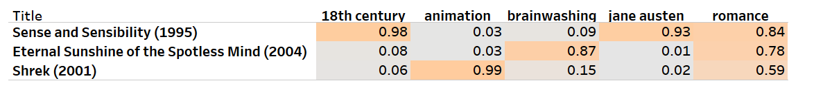
Variable Selection
Variable Selection
Algorithm Implementation
Data Preprocessing
Analyze Results
For every movie (movieID) we will use the following attributes:
Average rating: Ratings are made on a 5-star scale, with half-star increments (0.5 stars - 5.0 stars)
Number of ratings: not all users rated all movies
Genre indicates the genre(s) assigned to each movie by https://www.themoviedb.org/
Tag genome: genome encodes (from 0 to 1) how strongly movies exhibit particular properties represented by tags (atmospheric, thought-provoking, realistic, etc.). The tag genome was computed using a machine learning algorithm on user-contributed content including tags, ratings, and textual reviews (Vig et al., 2012). NOTE: individual tags dataset will be used later for comparison purposes
Fig. 1: Example of selected tag genomes for three movies

Slide 3
Data Preprocessing
Variable Selection
Algorithm Implementation
Data Preprocessing
Analyze Results
The input for the algorithm is a data frame where each row represents a unique movieId and the columns are the ratings, genre and tag genome attributes.
Each dataset will be processed independently and then joined by movieID
There are 58,098 movies with Genre information, 53,889 with Ratings and only 13,176 movies with tag genome.
NOTE: missing values are replaced in this exercise by 0’s.
UserID | MovieID | rating
1 | 1 | 4
1 | 3 | 4
…. | ….
283,228 | 70 | 3.5
MovieID | Title | genres
1 | Toy Story (1995) | Adventure|Animation|Comedy
2 | Jumanji (1995) | Adventure|Children|Fantasy
…. | ….
58,098 | Heat (1995) | Action|Crime|Thriller
MovieID | TagID | relevance
1 | 1 | 0.029
1 | 2 | 0.023
…. | ….
13,176 | 1,128 | 0.34
Ratings Dataset
Movies/Genres Dataset
Tag Genome Dataset
MovieID | Title | Adventure | ….. | Thriller | Avg Rating | # of ratings | 007 relevance | … | Zombies_relevance
1 | Toy Story (1995) | 1 | … | 0 | 3.88 | 68,469 | 0.029 | … | 0.022
2 | Jumanji (1995) | 1 | … | 0 | 3.65 | 27,143 | 0.036 | … | 0.019
…. | …. |  | … | … | … |  | … | … | …
58,098 | Heat (1995) | 0 | … | 1 | 3.84 | 28,683 | 0.028 | … | 0.023
Final table after preprocessing

Slide 4
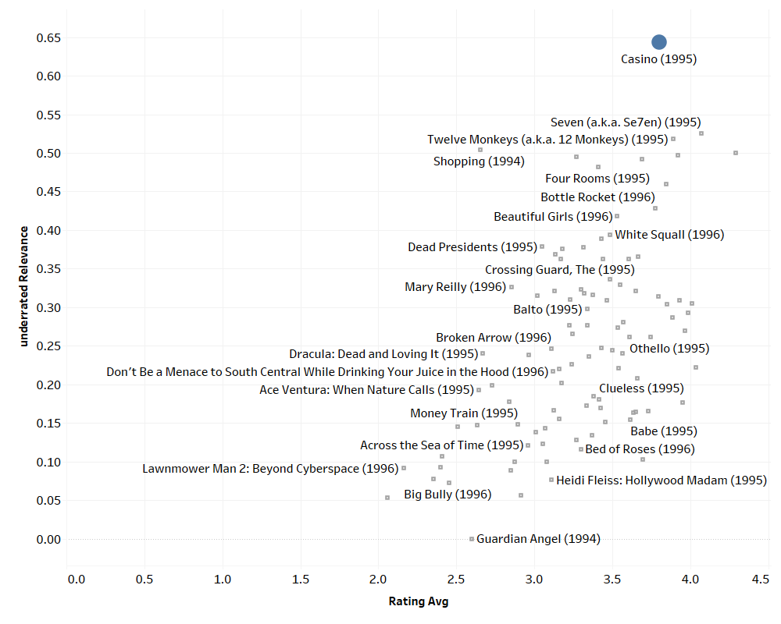
Algorithm Implementation
Variable Selection
Algorithm Implementation
Data Preprocessing
Analyze Results
The methodology used here to identify the 10 most similar movies of each movie is the k-Nearest Neighbor (K-NN).
k-NN is a machine learning algorithm that inputs items or users as data points in a feature space. It then seeks to solve the following query: given (N) objects in the feature space, find the (k) most similar objects or neighbors. The k-NN algorithm then identifies the (k) most similar objects by locating the data points that are closest in proximity to the (N) objects.
To locate data points to the items we are testing, k-NN must employ some type of metric to measure the distance between the data points in the feature space. In this exercise, we will use the euclidean distance
This distance metric is the key method a recommender uses to identify items or users that are similar to each other.
Fig. 1 Example of knn for “Casino” with two variables

Slide 5
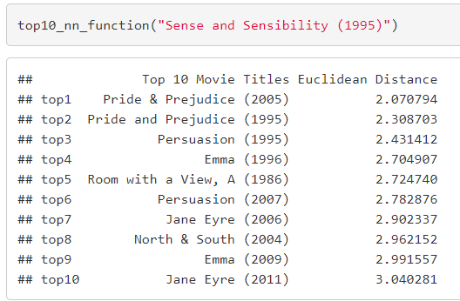
Analyze Results & Conclusions
Variable Selection
Algorithm Implementation
Data Preprocessing
Analyze Results
Results using tags only are good but the ones with the tags genome are even BETTER!!!!
Table. 1 Top 10 most similar movies for Toy Story, Sense and Sensibility and Casino using the tag genome dataset
Fig. 1 Output of top 10 function for “Sense and Sensibility”
Table. 2 Top 10 most similar movies for Toy Story, Sense and Sensibility and Casino using individual tags
Highlighted movies indicate possible mismatches

Slide 6
Appendix: R Markdown

Slide 7
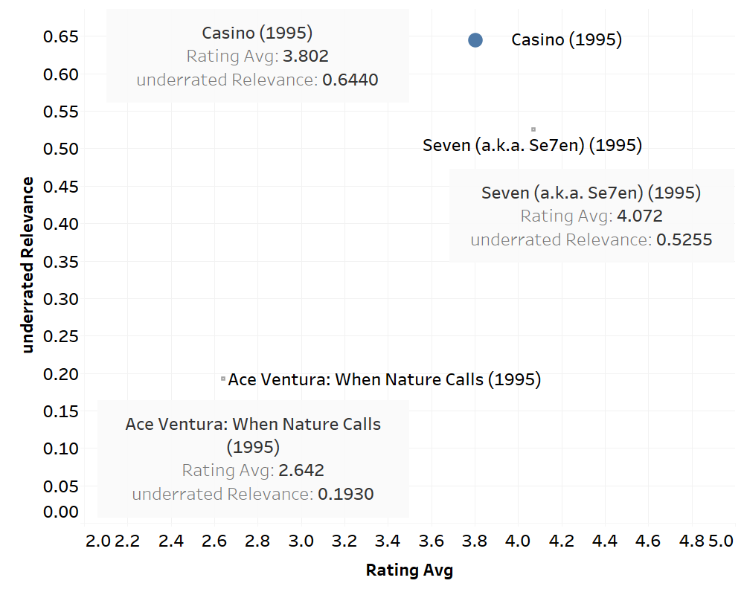
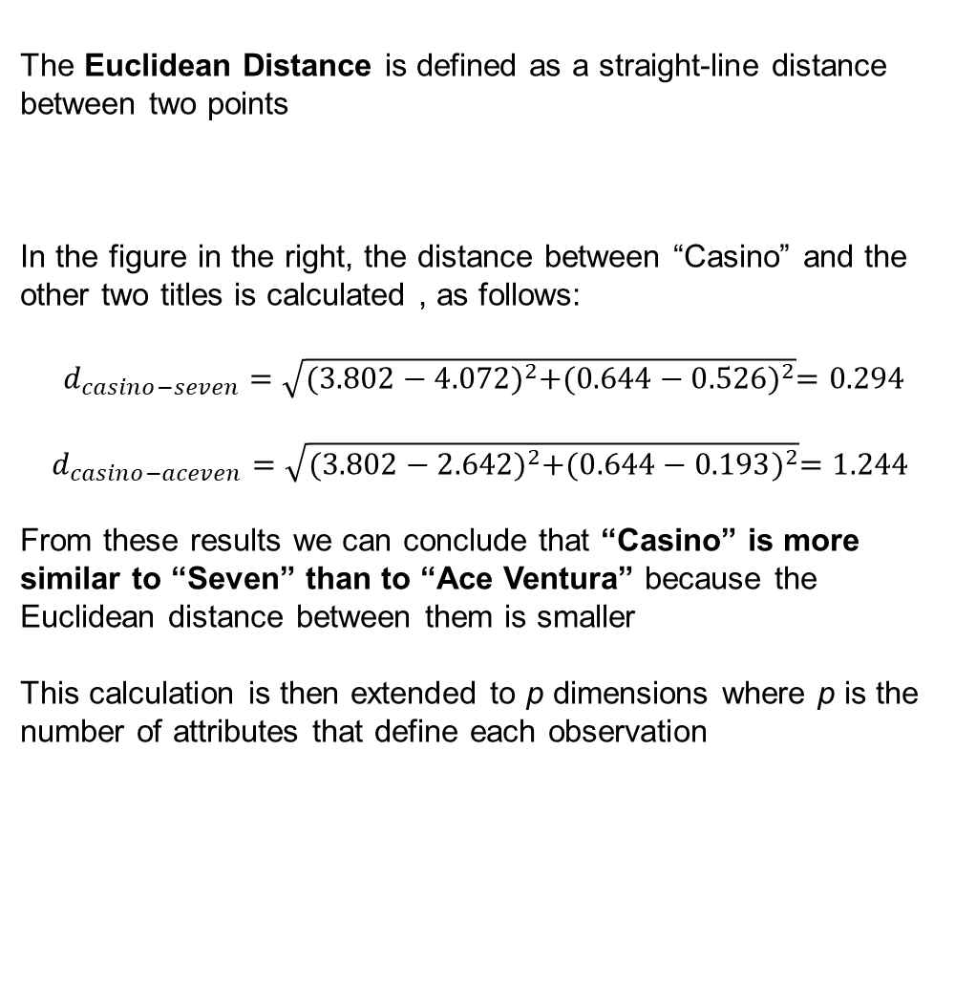
Appendix: Euclidean Distance Example
The Euclidean Distance is defined as a straight-line distance between two points
In the figure in the right, the distance between “Casino” and the other two titles is calculated , as follows:
$d_{casino−seven}=\sqrt{{(3.802−4.072)}^{2}+{(0.644−0.526)}^{2}}=0.294$
$$d_{casino−aceven}=\sqrt{{(3.802−2.642)}^{2}+{(0.644−0.193)}^{2}}=1.244$$
From these results we can conclude that “Casino” is more similar to “Seven” than to “Ace Ventura” because the Euclidean distance between them is smaller
This calculation is then extended to p dimensions where p is the number of attributes that define each observation

